Slide 1
Black Women, Reproductive Labor and the Meaning of Freedom
Alexis Williams
May 2018

Slide 2
Women and Work

Slide 3
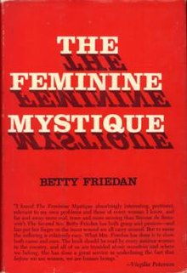
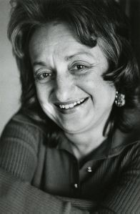
The Feminine Mystique by Betty Friedan
“The first step in that plan [to break free from unhappiness] is to see housework for what it is—not a career, but something that must be done as quickly and efficiently as possible.”
“This is not to say, that being a den mother, or serving on a PTA committee, or organizing a covered-dish supper is not useful work; for a woman of intelligence and ability, it is simply not enough.”

Slide 4
Women’s Liberation brings about a new standard for idealized femininity through “meaningful work” -- but what does that really mean?

Slide 5
Research Questions
What does the reorganization of women in the professional workforce over the last half-century and new standards of female empowerment mean for our understanding of womanhood? How does it work to erase and delegitimize Black women’s history of labor within households as well as their continued exclusion from much of professional life?
How were Black women imagined within, and more importantly, how did Black women imagine themselves in relation to Women’s Liberation?
How do patterns and discourses around labor produce and reproduce social categories and identities? Specifically, how do these negotiations mitigate or redefine the meaning of freedom for Black women and their communities?
What lessons can this time period offer us today?

Slide 6
Key Themes
Reproductive vs. productive labor
Intersectionality
Racialized Gender
Freedom

Slide 7
Elements of the Project
Historical Context
The Feminine Mystique and its Afterlives
Black Women and Women’s Lib
Conclusions

Slide 8
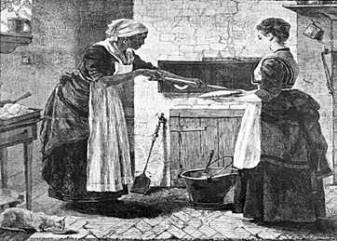
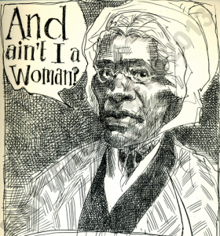
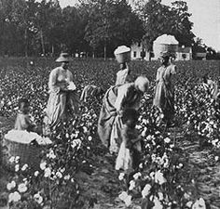
Reproducing Race and Gender Under Slavery
Childbearing
Distorting gendered implications of labor
Relationships between Black and white women

Slide 9
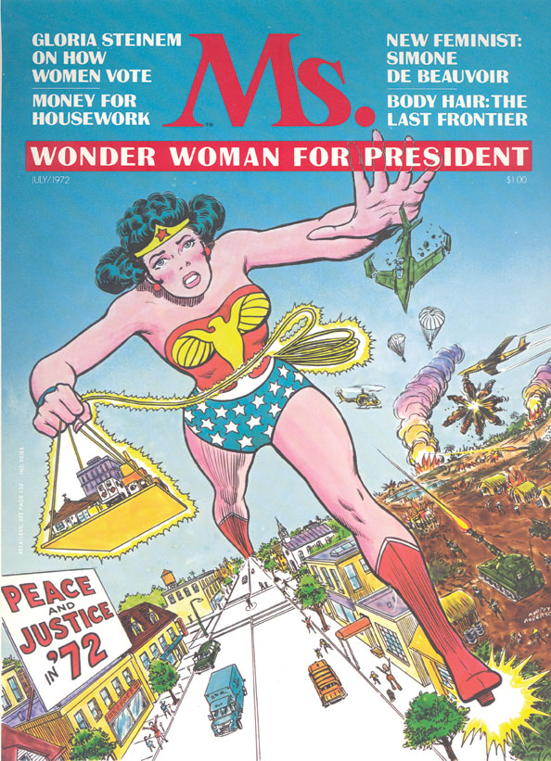
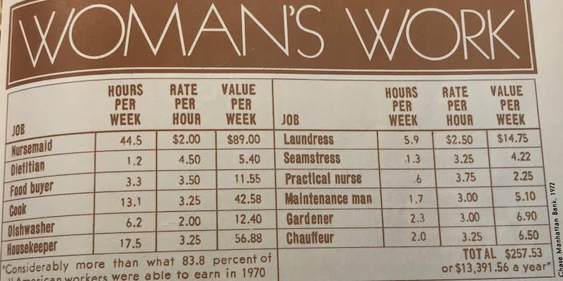
Women’s Lib Becomes a National Conversation
The meanings about women working begins to shift
Emphasis on the value of housework, but little discussion of hired domestic help, poorer women
Notes:
$73K annual salary in today’s money

Slide 10
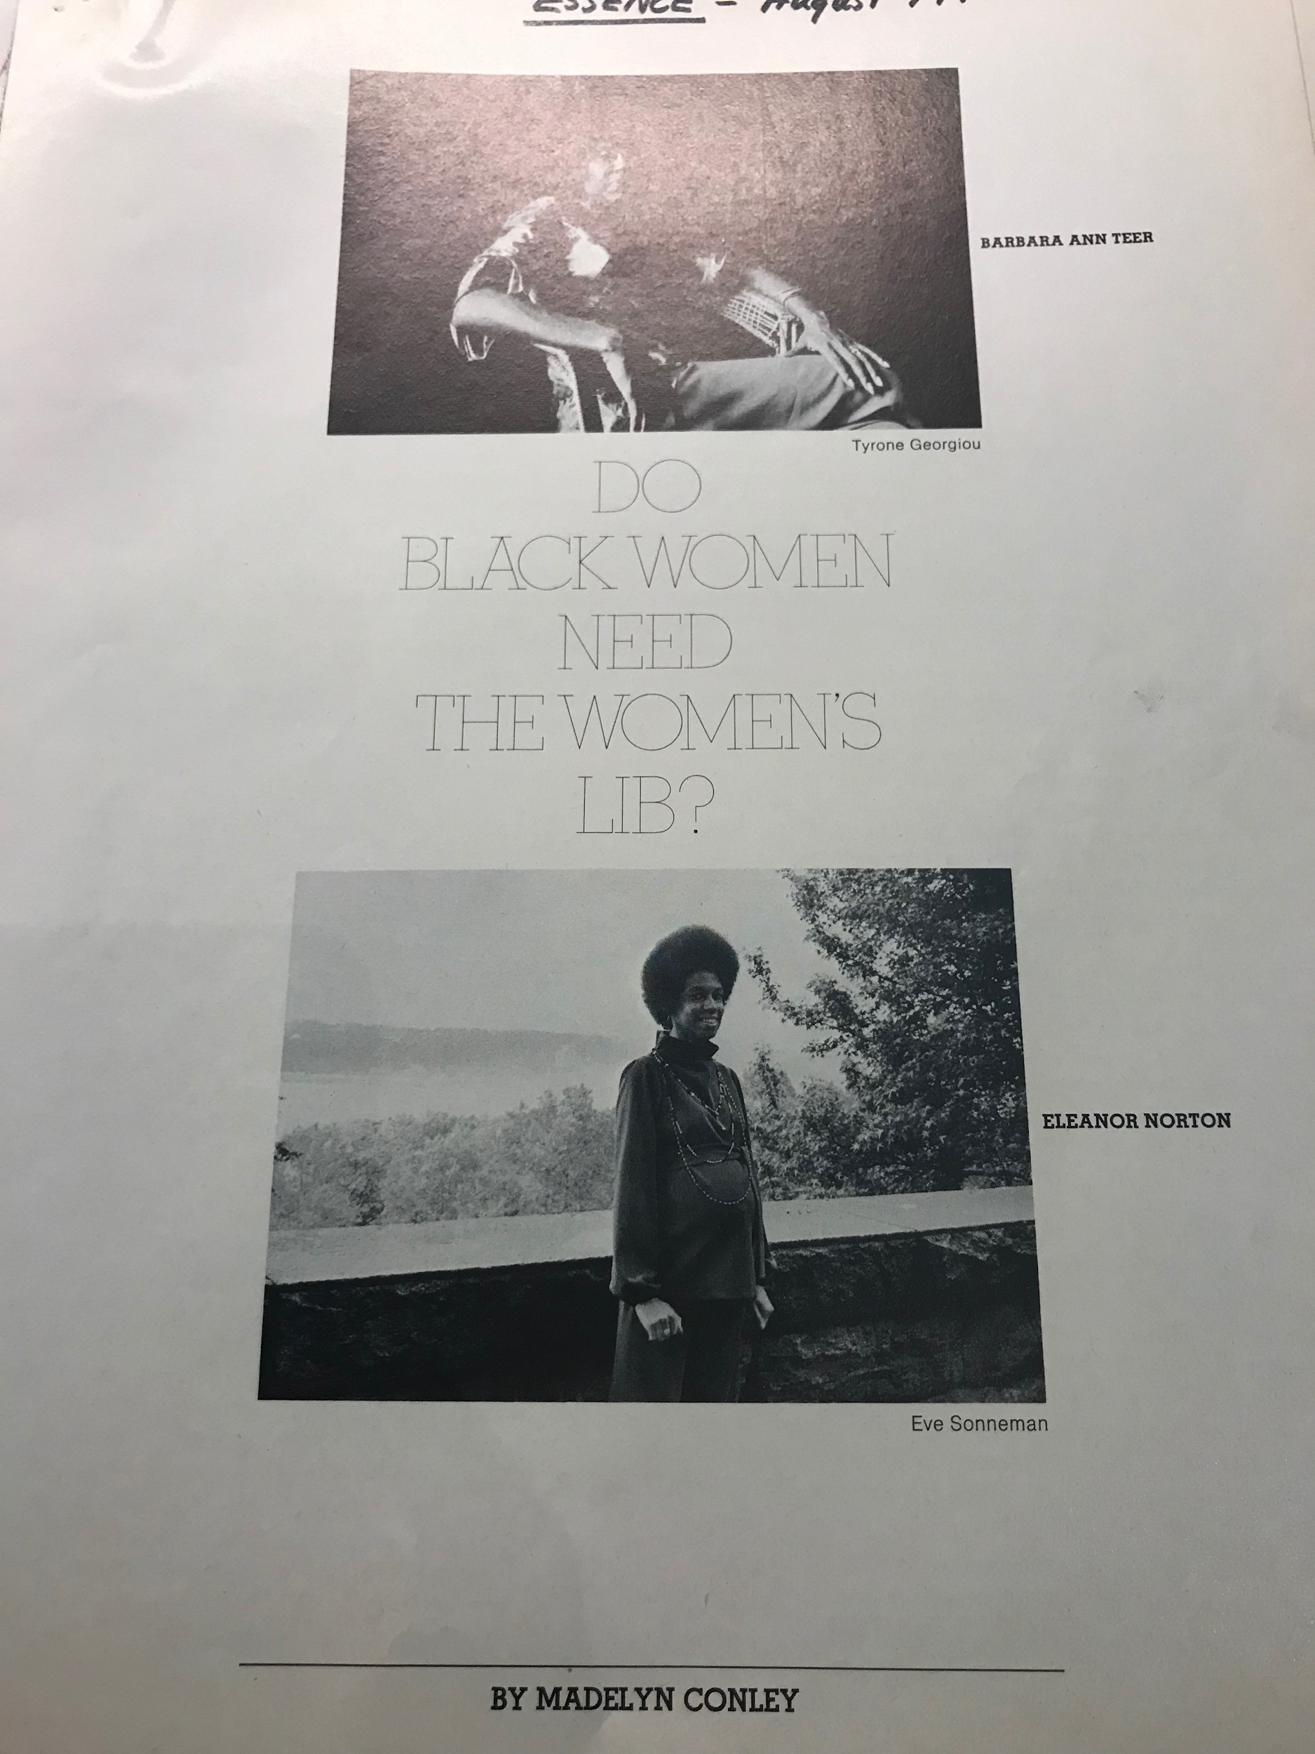
Black Women and Women’s Lib
Male Chauvinism in Black Power
Priorities within the Women’s Movement
Possibilities for Coalition

Slide 11
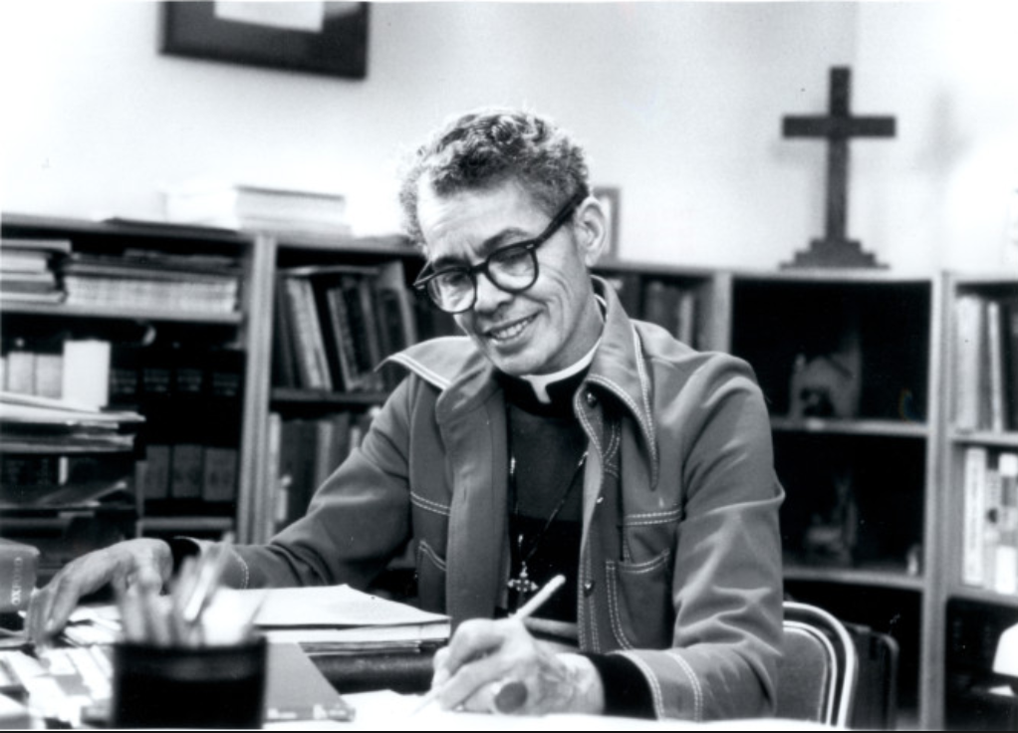
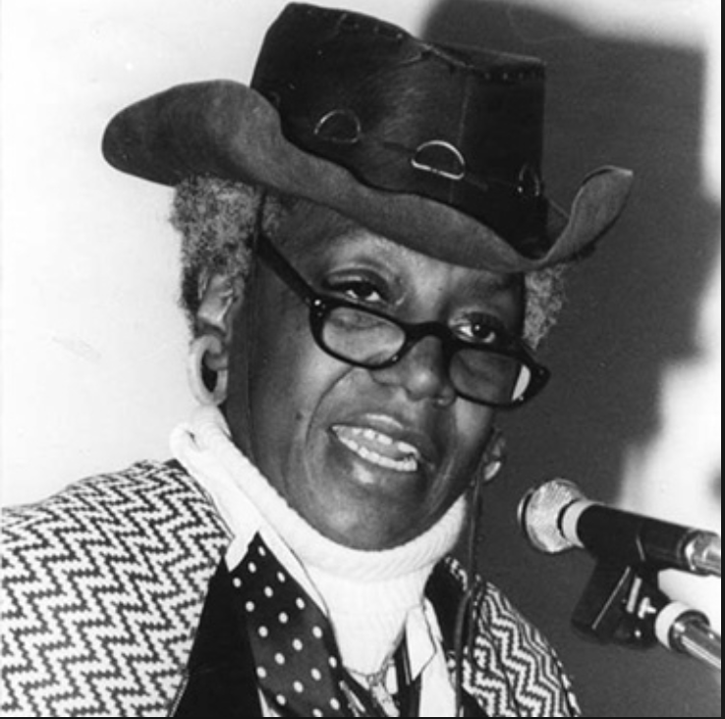
Black Women and Women’s Liberation
“As a human being, I cannot allow myself to be fragmented into Negro at one time, woman at another, and worker at another.”
-Pauli Murray, 1967
“They don't want to be used again to help somebody gain power—a power that is carefully kept out of their hands”
-Toni Morrison, 1971
“We aren't fighting for liberation; we are fighting for female equality within the black community”
-Sylvia Witts Vitale, 1973

Slide 12
I conclude is that while work is a central theme in feminist organizing across racial boundaries, the Women’s Liberation Movement reveals a failure to build strong and lasting coalitions based on shared economic empowerment.

Slide 13
However, this history offers us many lessons for our current moment to endow “female empowerment” with more meaningful and liberatory potential.

Slide 14
Questions?

