Slide 1
Delivering Difficult News
Curriculum Implementation and Assessment for Pediatric Trainees
Tanya D. Murtha, MD, MPH Yale Women’s Faculty Forum
Pediatric Critical Care Fellow Seed Grant Conference
Yale School of Medicine May 2nd, 2018
Notes:
Have a blurb of who I am

Slide 2
Disclosures
No disclosures

Slide 3
Background

Slide 4
Background
We give bad news
Have to tell patients and families
information that they are not
prepared to hear
Physicians are expected to know how to communicate
Including how to deliver difficult news empathetically
Notes:
Happens in nearly all aspects of life, both work and personal life
Accrediting body, the ACGME, has competencies related to communication that trainees are expected to meet, some specifically address delivering difficult news
See one, do one, teach one model
Think about talking about importance of effective communication
Some background on me
Techniques that can be used
Clinical scenario- like ALL or need life support to engage
Set the stage, basic

Slide 5
What is Difficult News?
Any information likely to drastically and negatively alter the patient’s view of his or her future
Robert Buckman
Notes:
It is in the eye of the beholder
We give difficult news
What is difficult news
We are expected to know how to deliver difficult news
We don’t feel comfortable delivering difficult news
Delivering difficult is a skill that can be learned
We don’t formally teach it at Yale Peds
A method for delivering difficult news has been developed
SPIKES
The AAP has a curriculum to teach pediatric trainees how to deliver difficult news
It has never been evaluated for effectiveness

Slide 6
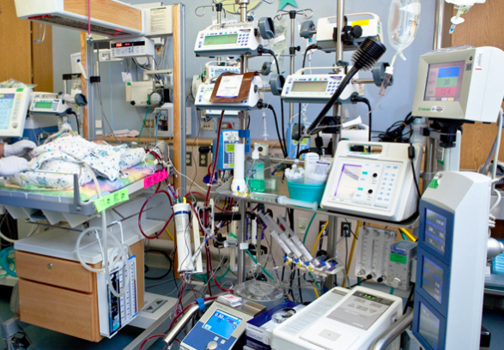
Clinical Example
9 year old girl with severe seizure disorder admitted to the Pediatric ICU with pneumonia
Worsening on maximal ventilator settings
Difficult news to deliver: May need to go on life support with heart-lung bypass
Requires surgery
40% of patients do not
survive this heroic
intervention

Slide 7
The Task of Delivering Difficult News “If we do it badly, the patients or family members may never forgive us; if we do it well, they may never forget us.” Robert Buckman
Notes:
Do it well doesn’t make the bad news better
But doing it badly absolutely can make it worse

Slide 8
The Bad News about Bad News
Clinicians report anxiety and dread when discussing serious diagnoses, impending death, and death
Anxiety and dread can compromise communication and intervention
How news is relayed affects the patients' capacity to cope
Affected by physician:
Character
Ability to build relationships
Hilden, 2001; Ahrens and Hart, 1997; Friedrichsen, 2000;
Notes:
Highlight more - a learnable skill/process
Particularly simulation

Slide 9
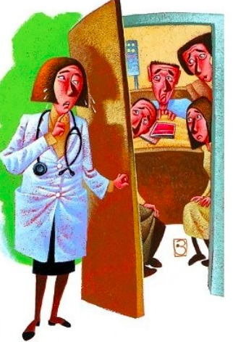
Pediatric Resident Discomfort with Delivering Difficult News
Kolarik, 2006
Notes:
Pediatric residents reported minimal training, experience, knowledge, competence, and comfort in delivering difficult news with No significant improvement over the years of training
Ranked giving diff news as 3/10 for palliative care education topics

Slide 10
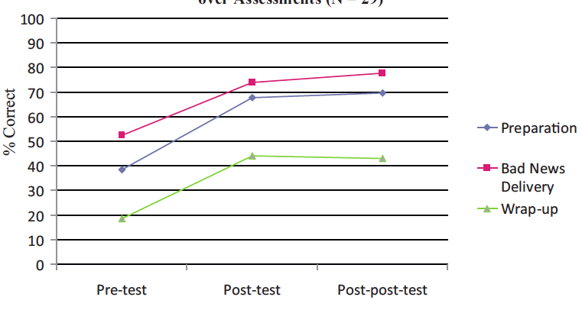
The Good News about Bad News
Communication training works and can make positive differences
After formal training, when giving difficult news, trainees report
Greater self-perceived skills
Better self-confidence
Greater comfort
Objective skill in delivering
difficult news can be
improved and sustained
Cushing and Jones, 1995, Vetto, 1999, and Greenberg; 1999, Reed, 2015
Notes:
Reed: didactic, small group, and role play once with GRIEV_ING protocol in peds residents

Slide 11
Current Training at Yale Pediatrics in Delivering Difficult News
Observation – Majority of learning
Variable exposure
Learners pick and choose methods that they have seen work… or not work
Trial and Error
Limited opportunity
Often unintentional disclosure of
bad news or news not perceived
as “bad” by the trainee
Didactics
Residents
Informal discussion of delivering difficult news with community primary care pediatricians
Death in the PICU lecture
See One
Do One
Teach One
Notes:
dependent on clinical experiences
Really bad news is done by attendings, sometimes fellows. Resident opportunity is limited
Fellows no formal teaching
The training paradigm of see one do one teach one falls apart without the teaching component
No standardized communication method taught
No simulation sessions or role play
No specific communication feedback

Slide 12
Hypothesis & Aims

Slide 13
Hypothesis
Baseline comfort and competence with delivering difficult news to the parents of pediatric patients is low in pediatric trainees
Therefore:
The implementation of a formal curriculum on delivering difficult news will improve pediatric trainees’ self-efficacy and skill in delivering difficult news

Slide 14
Aims
Implement a formal curriculum on learning to deliver difficult news for pediatric trainees at Yale New Haven Children’s Hospital
Assess effectiveness of the curriculum
Self-efficacy
Knowledge
Confidence
Comfort
Objective improvement
Observed Structured
Clinical Examinations

Slide 15
Methods

Slide 16
Methods: Intervention
Study Population
Pediatric Trainees at YNHCH
Residents
Fellow
Intervention: Curriculum Implementation
Curriculum: Resilience in the Face of Grief and Loss
Published by the American Academy of Pediatrics
Uses the SPIKES model
Provides discussion guides, didactic slides, & role play scenarios
Implementation: Delivering difficult news educational sessions
Didactic, discussion, and observed role play
Role play examples of poor and ideal performance
Active role play (Fellows)
Notes:
There are 48 pediatric fellows and 78 residents who rotate through pediatrics (60 general pediatrics, 16 medicine-pediatrics, and 2 pediatric psychiatry residents).
Didactic: spikes and nurse
observed role play of good and bad example of delivering difficult news
AAP b/c available to all, uses SPIKES, and reviewed by a panel of experts
But hasn’t been tested

Slide 17
SPIKES
Set-up
Perception
Invitation
Knowledge
Empathy and Emotion
Strategy and Summary
Baile, 2000
Notes:
No data to support its impact, but is widely used, especially in oncology
Arrange for privacy, manage interruptions (phone), review the chart, involve others (RN, Social work, child life), sit down, and introduce everyone
Always get information before you give information: What have the doctors told you…” or What is your understanding of…”
Ask how the patient / family likes to receive information (the “big picture” or details), ask if anyone else should be present, and give a warning shot: "Unfortunately the news is not what we had hoped for..." or "I am sorry but I have some information which may be hard to hear..."
AVOID JARGON: “Doctors sometimes use words that not everyone understands. Please stop me if I’m doing this.” Avoid euphemisms, give information in small pieces, and check understanding frequently
Let them know you have connected with their emotions, STOP TALKING, observe the emotion, identify the emotion, and explore the reason for the emotion (NURSE mnemonic)
Check overall understanding, recap goals, discuss the plan, probe for questions, and document the discussion
AAP Resilience in the Face of Grief and Loss Curriculum
Back et al. CA Cancer J Clin.2005; 55:164-177

Slide 18
Methods: Assessment
Evaluation of the curriculum
Self-efficacy survey
Residents and Fellows
Self assessment of 13 components of delivering difficult news
Knowledge
Competence
Comfort
Demographics
Timing
Immediately pre- and post-educational session
Surveys linked for individual pre-post comparison
Notes:
Age, gender, and level of training
Previous formal training in delivering difficult news and where this occurred

Slide 19
Self-Efficacy Survey
I feel: | KNOWLEGEABLE about how to… | CONFIDENT in my ability to… | COMFORTABLE when I…
1 |  |  |  | Break bad news in general
2 |  |  |  | Create a supportive environment
3 |  |  |  | Reduce or eliminate signs that I am nervous or anxious
4 |  |  |  | Use language that is nontechnical and easily understood
5 |  |  |  | Adjust the rate and amount of information I provide
6 |  |  |  | Listen to parents’ concerns
7 |  |  |  | Explore a parents’ concerns
8 |  |  |  | Empathize with a parent
9 |  |  |  | Avoid portraying more hope or optimism than I believe exists to deal with parents’ emotions
10 |  |  |  | Summarize information in a way that is easy to understand
11 |  |  |  | Anticipate possible responses by parents
12 |  |  |  | Deal with difficult emotions from families
13 |  |  |  | Close the conversation in an appropriate way
Notes:
A senior paediatric resident completed a survey for each admitted patient. A positive result was selection of one or more of the first four criteria. A negative result occurred with selection of the null criteria, the fifth survey question.

Slide 20
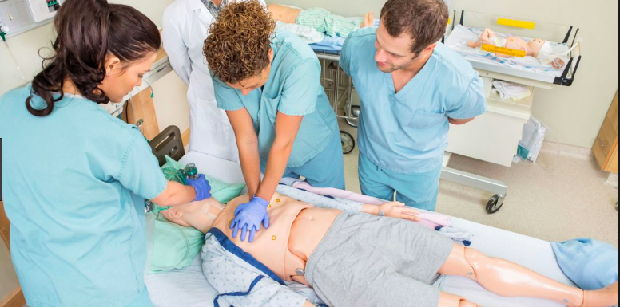
Methods: Objective Evaluation
Observed Structured Clinical Examinations (OSCE)
Used in medical education to test clinical skills
Physical exam, taking a history
Form of simulation
Fellows to participate
Trained standardized patients (SP)
Acting as parents
Scenarios from AAP curriculum
Evaluations
SPIKES checklist
Master Interview Rating Scale (MIRS)
Timing
Baseline skill prior to the educational session
1-3 months after the educational session
Notes:
OSCE used to test medical student skill in taking a medical history or performing a physical exam
Also used to test advanced communication skills

Slide 21
OSCE Evaluation
SPIKES checklist – 14 items
Performance of SPIKES-anchored behaviors
Scoring: 0 – inadequate or not done, 1 – adequate, 2 – good
MIRS – 9 items
Assessment of overall communication skill
Modified for use in advanced communication OSCEs at YSM
Scoring: Anchored scale from 1 to 5
Evaluators
In-person observer
Post hoc scoring via video review
Blinded to pre- and post-curriculum OSCE
Notes:
70% completion for “competency” Reed
Spikes checklist :Generate average score for each item from each observer → sum for total score
MIRS: Generate average score for the rating scale for each observer → average for final average score

Slide 22
OSCE Evaluation – SPIKES Checklist
Tobler, 2014

Slide 23
OSCE Evaluation – Modified MIRS
Notes:
Some overlap with SPIKES checklist

Slide 24
Data Analysis
Dependent t-test
Self-efficacy survey pre and post composite scores
The pre and post OSCE SPIKES checklist total score
The pre and post OSCE modified MIRS average mean
Chi Square
Demographic survey data
Kappa evaluations
Comparing the in-person OSCE observer and the post hoc OSCE video review
SPIKES checklist
Modified MIRS

Slide 25
Preliminary Results

Slide 26
Results: Comparison of Component Composite Scores
3: Neither Agree or Disagree
4: Agree
Notes:
14 subjects
1st lecture to residents

Slide 27
Results: Knowledge
3: Neither Agree or Disagree, 4: Agree

Slide 28
Results: Confidence
p=0.002
3: Neither Agree or Disagree, 4: Agree

Slide 29
Results: Comfort
p=0.01

Slide 30
Composite Score of Knowledge, Confidence, & Comfort
Skills of delivering difficult news: | PRE | SD |  | POST | SD |  | p-value
Break bad news in general | 3.22 | 1.05 |  | 3.84 | 0.99 |  | 0.000
Create a supportive environment | 3.85 | 0.71 |  | 4.30 | 0.65 |  | 0.000
Reduce or eliminate signs that I am nervous or anxious | 3.27 | 0.89 |  | 3.89 | 0.82 |  | 0.000
Use language that is nontechnical and easily understood | 3.74 | 0.89 |  | 3.95 | 0.78 |  | 0.058
Adjust the rate and amount of information I provide | 3.56 | 0.86 |  | 3.87 | 0.88 |  | 0.011
Listen to parents’ concerns | 4.29 | 0.69 |  | 4.25 | 0.63 |  | 0.624
Explore a parents’ concerns | 4.00 | 0.77 |  | 4.18 | 0.75 |  | 0.021
Empathize with a parent | 4.05 | 0.91 |  | 3.97 | 0.79 |  | 0.535
Avoid portraying more hope or optimism than I believe exists to deal with parents’ emotions | 2.90 | 1.01 |  | 3.60 | 0.80 |  | 0.000
Summarize information in a way that is easy to understand | 3.84 | 0.82 |  | 4.05 | 0.75 |  | 0.006
Anticipate possible responses by parents | 3.19 | 0.93 |  | 3.67 | 0.83 |  | 0.000
Deal with difficult emotions from families | 3.14 | 0.99 |  | 3.70 | 0.91 |  | 0.000
Close the conversation in an appropriate way | 3.17 | 0.95 |  | 3.65 | 1.03 |  | 0.000
Notes:
DECIDE WHAT TO DRAW ATTENTION TOO

Slide 31
Discussion
Delivering difficult news is a complex, difficult skill
It is not just a skill of physicians
Pediatric trainees should receive formal training
How it is done affects patients
Advanced communication skills can be taught
SPIKES provides a framework
The AAP curriculum is effective
Led to improved self-efficacy
At least in the short term

Slide 32
Next Steps: Project Planning
Spring and summer
Complete resident education sessions
Train standardized patients
Schedule pre-OSCEs
Schedule faculty and resident focus groups
Fall
Implement fellow didactics
Schedule post-OSCEs
Winter
Post hoc scoring of all OSCEs
Data analysis
Present at conferences
Spring
Write manuscript
Repeat didactics with residents

Slide 33
Next Steps: Beyond Educational Sessions
Integrate SPIKES method into daily communication
Provide opportunities for simulation in delivering difficult news for all pediatric trainees
Measure impact of training on family experience of receiving difficult news
Measure impact of improved skill in delivering difficult news on physician well-being
Launch my career in helping families and physicians cope with the hardest moments of their lives and our careers

Slide 34
References
Vanderford ML, Stein T, Sheeler R, Skochelak S. Communication challenges for experienced clinicians: topics for an advanced communication curriculum. Health Commun. 2001;13(3):261-84. doi:10.1207/S15327027HC1303_3.
Ang M. Advanced communication skills: conflict management and persuasion. Acad Med. 2002;77(11):1166.
Benson BJ. Domain of competence: Interpersonal and communication skills. Acad Pediatr. 2014;14(2 Suppl):S55-65. doi:10.1016/j.acap.2013.11.016.
Kolarik RC, Walker G, Arnold RM. Pediatric resident education in palliative care: a needs assessment. Pediatrics. 2006;117(6):1949-54. doi:10.1542/peds.2005-1111.
Carter BS, Howenstein M, Gilmer M, Throop P, France D, Whitlock J. Circumstances surrounding the deaths of hospitalized children: opportunities for pediatric palliative care. Pediatrics. 2004;114(3). Available at: www.pediatrics.org/cgi/ content/full/114/3/e361 18. Bowen K, Marshall W. Pediatric deat
Bagatell R, Meyer R, Herron S, Berger A, Villar R. When children die: a seminar series for pediatric residents. Pediatrics. 2002;110:348–353
Contro NA, Larson J, Scofield S, Sourkes B, Cohen HJ. Family perspectives on the quality of pediatric palliative care. Arch Pediatr Adolesc Med. 2002;156:14–19
Contro NA, Larson J, Scofield S, Sourkes B, Cohen HJ. Hospital staff and family perspectives regarding quality of pediatric palliative care. Pediatrics. 2004;114:1248–1252
Kern DE. Curriculum Development for Medical Education: A Six-Step Approach. Baltimore: The Johns Hopkins University Press; 1998.
Hafler JP. Extradordinary Learning in the Workplace. Innovation and Challenges in Profressional Education, vol 6. Dordrecht: Springer; 2011.
Baile WF, Buckman R, Lenzi R, Glober G, Beale EA, Kudelka AP. SPIKES-A six-step protocol for delivering bad news: application to the patient with cancer. Oncologist. 2000;5(4):302-11.
Ellman MS, Fortin AHt. Benefits of teaching medical students how to communicate with patients having serious illness: comparison of two approaches to experiential, skill-based, and self-reflective learning. Yale J Biol Med. 2012;85(2):261-70.
References:
Serwint JR, Bostwick S, Burke AE, Church A, Gogo A, Hofkosh D, et al. The AAP Resilience in the Face of Grief and Loss Curriculum. Pediatrics. 2016;138(5).
Benson BJ. Domain of competence: Interpersonal and communication skills. Acad Pediatr. 2014;14(2 Suppl):S55-65.
Kolarik RC, Walker G, Arnold RM. Pediatric resident education in palliative care: a needs assessment. Pediatrics. 2006;117(6):1949-54.
Baile WF, Buckman R, Lenzi R, Glober G, Beale EA, Kudelka AP. SPIKES-A six-step protocol for delivering bad news: application to the patient with cancer. Oncologist. 2000;5(4):302-11.
Friedrichsen MJ, Strang PM, Carlsson ME. Breaking bad news in the transition from curative to palliative cancer care--patient's view of the doctor giving the information. Support Care Cancer. 2000;8(6):472-8.

Slide 35
Thank you!
Special thanks to Sarah Kandil, Andrea Asnes, Janet Hafler, Stephanie Massaro, Kathleen Ang, and Pnina Weiss for their mentorship.
Special thanks to the Yale Women’s Faculty Forum for supporting this research.

